Slide 1
Stem and Leaf

Slide 2
Stem and Leaf
In a stem-and-leaf plot each data value is split into a "stem"
and a "leaf". The "leaf" is usually the last digit of the number
and the other digits to the left of the "leaf" form the "stem".
To show a one-digit number (such as 9) using a stem-and-
leaf plot, use a stem of 0 and a leaf of 9.
To show a two-digit number (such as 25), the stem is 2 and the leaf is the 5.
If the observed value is a three-digit number (such as 369), the stem is 36 and the leaf is 9.
If the observations are accurate to one or more decimal places, such as 23.7, the stem is 23 and the leaf is 7.

Slide 3
Stem-and-Leaf
HOW TO MAKE A STEM-AND-LEAF DISPLAY
Divide the digits of each data value into two parts. The "leaf" is usually the last digit of the number and the other digits to the left of the "leaf" form the "stem".
Align all the stems in a vertical column from smallest to largest. Draw a vertical line to the right of all the stems.
Place all the leaves with the same stem in the same row as the stem, and arrange the leaves in increasing order.
Use a label to indicate the magnitude of the numbers in the display. We include the decimal position in the label rather than with the stems or leaves.

Slide 4
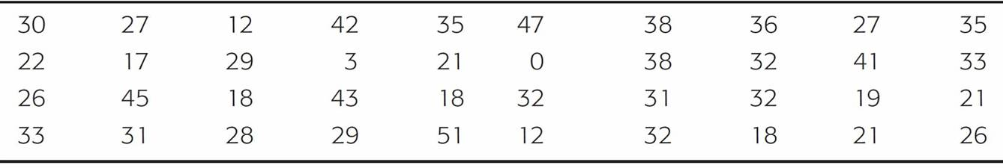
Example – Stem and Leaf
In this example, we will make a stem-and-leaf display.
Many airline passengers seem weighted down by their carry-on luggage. Just how much weight are they carrying?
The carry-on luggage weights in pounds for a random sample of 40 passengers returning from a vacation to Hawaii were recorded (see Table below).
Weights of Carry-On Luggage in Pounds
Table 2-15

Slide 5
Example – Stem and Leaf
cont’d
To make a stem-and-leaf display, we divide each data value into two parts.
The weights in our example consist of two-digit numbers. For a two-digit number, the stem selection is obviously the left digit. In our case, the digit in the tens place will form the stems, and the digit in the units place will form the leaf.
For example, for the weight 12, the stem is 1 and the leaf is 2. Since the data range from 0 to 51, the stems range from 0 to 5.

Slide 6
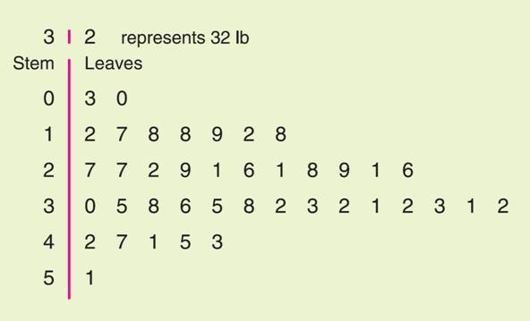
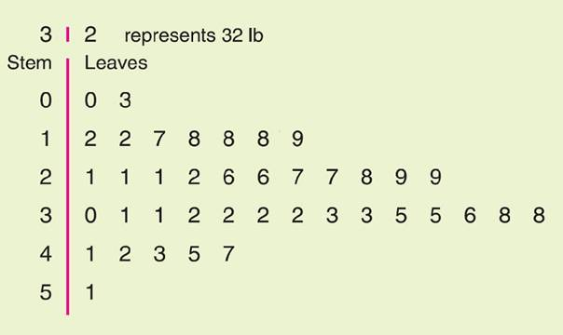
Example – Stem and Leaf
cont’d
In the stem-and-leaf display, we list each possible stem once on the left and all its leaves in the same row on the right, as in Figure 2-15(a). Then we order the leaves as shown in Figure 2-15(b).
Note: Do not separate the leaves by commas.
(a) Leaves Not Ordered
(b) Final Display with Leaves Ordered
Stem-and-Leaf Displays of Airline Carry-On Luggage Weights
Figure 2-15

Slide 7
Practice problem #1:
One sportswriter listed the winning scores of the conference championship games over the last 35 years. The scores for those games follow below.
132 118 124 109 104 101 125 83 99 131
98 125 97 106 112 92 120 103 111 117
135 143 112 112 116 106 117 119 110 105
128 112 126 105 102
i) Make a Stem-and-leaf display.
ii) Looking at the distribution, would you say that it is fairly symmetrical?

Slide 8
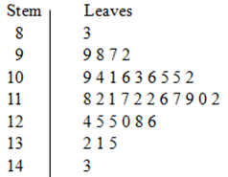
Practice problem #1:
i) Make a Stem-and-leaf display.
1). We break the digits of each data value into two parts. Use the
leftmost two digits as stem, and the single rightmost digit
as leaf.
2). Since the data range from 83 to 181,
the stems range from 8 to 18.
Align all the stems in a vertical column
from smallest to largest.
Draw a vertical line to the right of all
the stems. Write each leaf in the row to
the right of its stem.

Slide 9
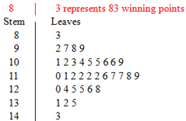
Practice problem #1:
3). Rearrange the leaves in increasing order. And indicate the scale.
ii) Looking at the distribution, would you say that it is fairly symmetrical?
Yes. Notice that stem 11 has the most data.

Slide 10
Practice problem #2:
The weights (to the nearest tenth of a kilogram) of 30 students were measured and recorded as follows:
59.2 61.5 62.3 61.4 60.9 59.8 60.5 59.0 61.1 60.7 61.6 56.3 61.9 60.4 62.2 58.9 59.0 61.2 62.1 61.4 58.4 60.8 60.2 62.7 60.0 59.3 61.9 61.7 58.4 59.9
Draw a stem-and-leaf display for the data. Briefly comment on what the analysis shows.
In this case, the stems will be the whole number values and the leaves will be the decimal values.
The data range from 56.3 to 62.7, so the stems should start at 56 and finish at 62.

Slide 11
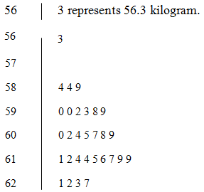
Practice problem #2:
Weights of 30 students
Note: leave this one blank
We say that the distribution is skewed to the left. This stem and leaf display reveals that the group with the highest number of observations recorded is the 61.0 to 61.9 group.

